Slide 1
Architecting intelligent content management software as a service for Cuba’s enterprises
Adrian Hernández-Méndez*, Nastaran Matthes+, and Florian Matthes#

Slide 2

Technische Universität München
13 Faculties
      Mathematics & Informatics
      Natural Sciences
      Engineering & Architecture
      Life Sciences & Medicine
      Economics & Education
32.000 Students
2.800 Informatics Faculty
478 Professors
48 Informatics Faculty
13 Nobel Prize winners
* 2012

Slide 3
Overview
1. Intelligent Content Management Software
  What is intelligent content (IC)?
  What is intelligent content management software?
2. A Model-Based ICMSaaS Architecture
  Architectural overview
  A practical example
  ICMSaaS as a platform for data-intensive apps
3. Summary and Future Research

Slide 4
What is intelligent content? (1/2)
Intelligent content (IC) has two main properties:
It is structurally rich and semantically categorized.
These properties are sufficient for making IC automatically discoverable, reusable, reconfigurable, and adaptable (Rockley & Cooper, 2012).
Our model of IC has three components:
  Content types
  e.g. Contact, Task, Opportunity
  Relations between content types
  e.g. Assigned_To, Reponsible
  Relations between similar instances
Schema, Taxonomy, Ontology
Database, Content Repository,
File System
  All three can change over time

Slide 5
What is intelligent content? (2/2)
A (content) Instance has
  Fields of basic data types (text, file, hypertext, image, number, enumeration)
    Maybe multi-valued
  Relations to other instances
    Associations (can be traversed in both directions)
    Aggregation hierarchy
  A content type that semantically categorizes the instance and constrains
    the structure of the instance
    and its possible relations to other instances
  All three can change dynamically over time.

Slide 6
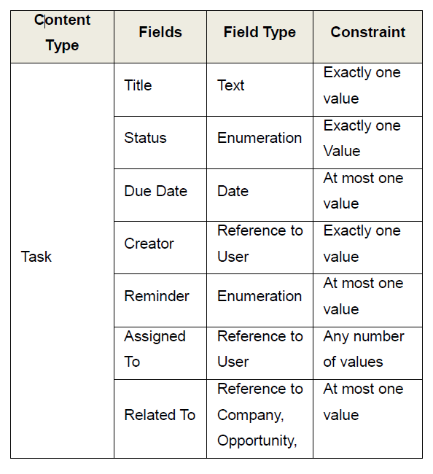
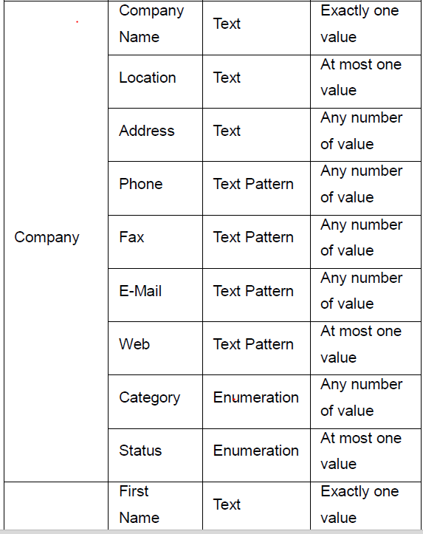
Examples of content types
Contact
…

Slide 7
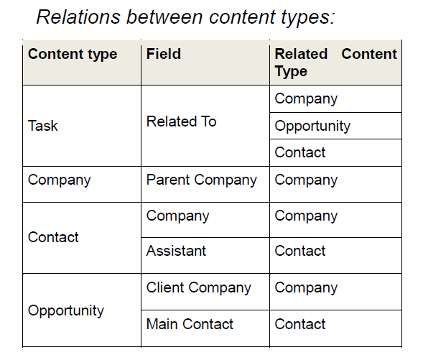
Inference and discovery of content types

Slide 8
What is intelligent content management software?
Employees
Partners
Customer
Suppliers
Communities
Hierarchical Groups,
Access Control Lists
Single Sign On
CRUD
Bidirectional linking
Data widgets
Classification & Tagging
Google⁺ search
Navigation, Discussion
Alerting & Awareness
Uniform Services
for Web & Desktop
Types, Relations,
Hypertext, Tags
Semi-structured Content
(collect, organize, edit)
Work Spaces
(share, communicate)
Business Objects
(access, manage)
Office
Documents
Web Links
Notes
Office
Documents
Wikis
News
Customer
Task
Company
Contacts
Personal
Profile
Blogs
Templates
Tasks
Forum
Opportunity
Statistics
Other
Information
Personal Content
Teamwork
Enterprise Content

Slide 9
Overview
1. Intelligent Content Management Software
  What is intelligent content (IC)?
  What is intelligent content management software?
2. A Model-Based ICMSaaS Architecture
  Architectural overview
  A practical example
  ICMSaaS as a platform for data-intensive apps
3. Summary and Future Research

Slide 10
Architectural Overview
Enterprise
Architecture Management
Risk
Management
Project Management
Contact
Management
Problem-specific
applications
Visualization and Interaction Layer
View Models
Coordination Layer
Tasks & Cases
Computation Layer
Methods & Functions
Access Control Layer
Authorization Models
Data Modeling Layer
Data Models
Storage Layer
Self-describing Content
Intelligent content management platform (as a service)

Slide 11
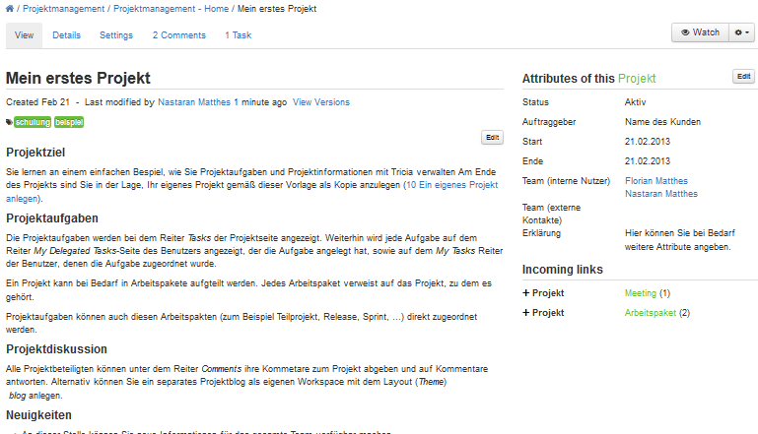
Generic model-driven visualization of intelligent content (1/2)
Content Type
Fields
Relations
Inverse
Relations
Unstructured Content

Slide 12
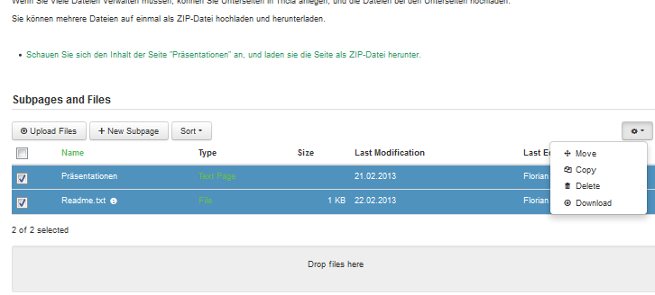
Generic model-driven visualization of intelligent content (2/2)
Aggregated Content
Visit http://wwwmatthes.in.tum.de and www.infoAsset.de for more information on Hybrid Wikis and Tricia.

Slide 13
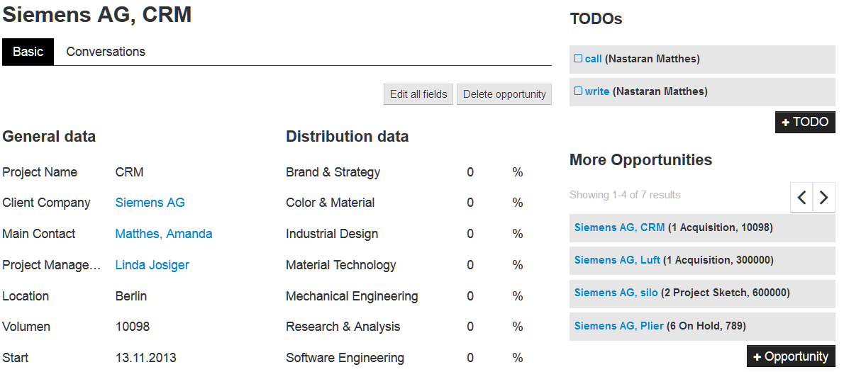
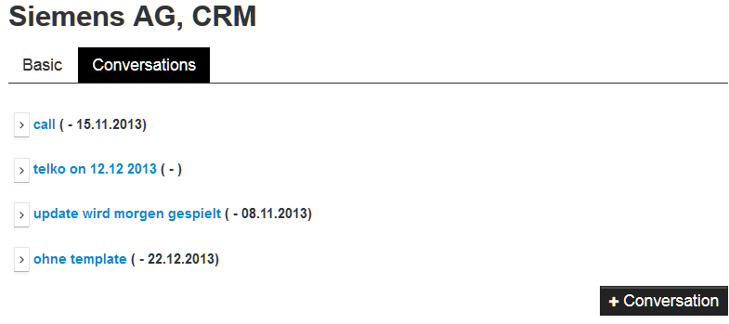
Visualizing intelligent content (Tricia data widgets)

Slide 14
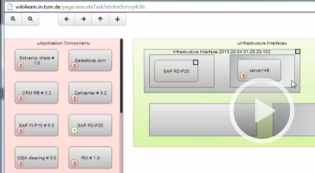
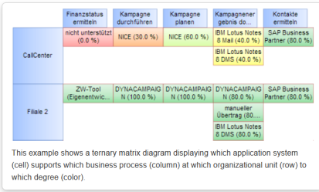
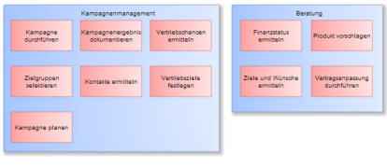
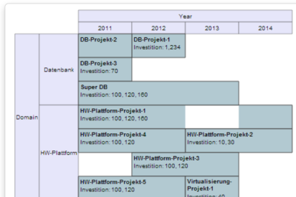
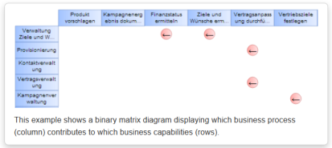
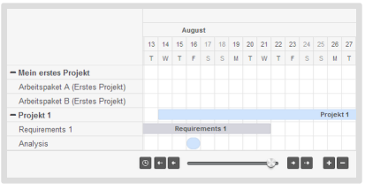
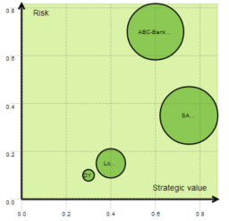
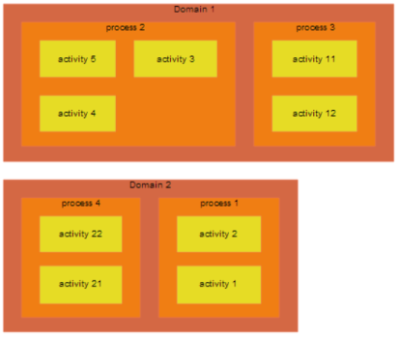
Visualizing intelligent content (Tricia data widgets)

Slide 15
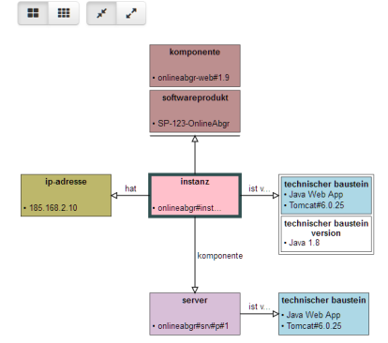
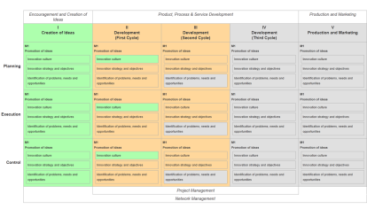
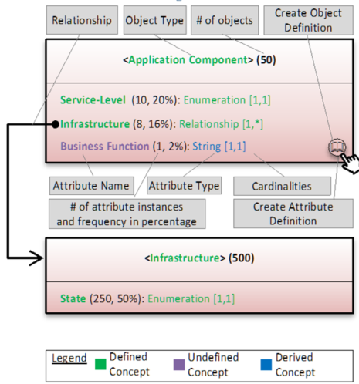
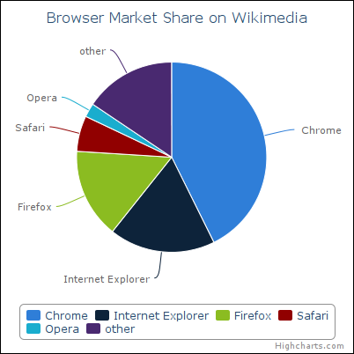
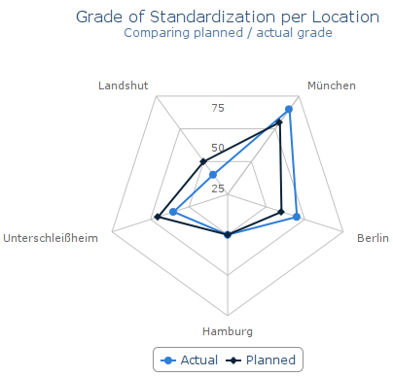
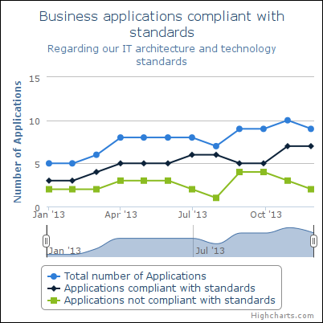
Visualizing intelligent content (Tricia data widgets)
Link

Slide 16
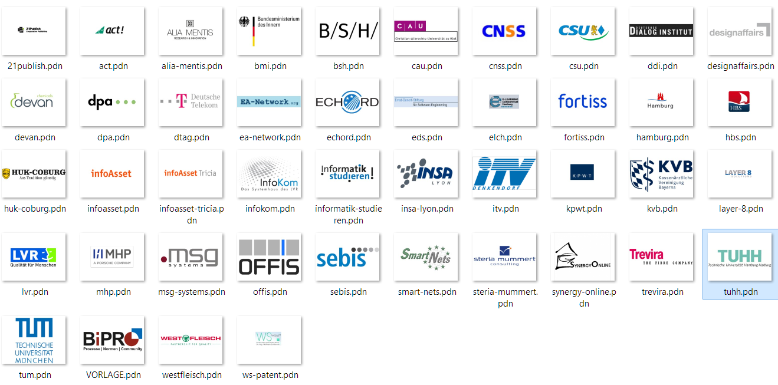
German companies & institutions using the
Tricia intelligent content management platform

Slide 17
Overview
1. Intelligent Content Management Software
  What is intelligent content (IC)?
  What is intelligent content management software?
2. A Model-Based ICMSaaS Architecture
  Architectural overview
  A practical example
  ICMSaaS as a platform for data-intensive apps
3. Summary and Future Research
.g

Slide 18
Key benefits
Reduced time to market & increased flexibility
Enterprise
Architecture Management
Risk
Management
Project Management
Contact
Management
Problem-specific
applications
View Models
Tasks & Cases
Methods & Functions
Authorization Models
Data Models
Self-describing Content
Intelligent content management platform (as a service)

Slide 19











Future Work
Intelligent Content + Calculations ➔ Spreadsheets 2.0
Content
Functions / Transformations
Visualizations
Users
$$f$$
$$f$$
$$f$$
$$f$$
$$f$$
$$f$$
$$f$$
$$f$$
$$f$$
$$f$$
$$f$$

Slide 20
Thank you for your attention. Questions?
Florian Matthes
Prof.Dr.rer.nat.
17132
matthes@in.tum.de

